Slide 1
Week 2 – Story Estimation, Sprint Planning, & Capacity
Michael Dempewolf
October 27, 2016

Slide 2

Agenda
Review
Story Estimation
Sprint Planning
Capacity
Story Board
Burn-down Chart

Slide 3

Review
What is the Agile Manifesto?
What is Scrum?
What are the Roles of Scrum?
What are the ceremonies/events of Scrum?
What are the artifacts of Scrum?
What is a sprint?

Slide 4
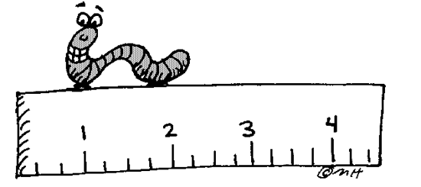

Story estimation
Assign an estimate for a user story
Product Owner prepares stories for estimation
Scrum Master provides past user story examples
Team assigns the estimate
Can be done at anytime – must be timeboxed!

Slide 5

Story Estimation – Product Owner
Product Owner brings a group of user stories to team for estimation
Product Owner describes the user story
Why it is important (user, company, strategic)
Describes the functionality/feature
Describes the workflow
Time boxed! Scrum Master limits it to a set amount of time (e.g. 5 minutes)

Slide 6

Story estimation – Scrum Master
Facilitates the Story Estimation event
Time boxes the session and each user story discussion
Coaches/Mentors Scrum principles
Provides examples of past user stories with their story point assignment
Calls for the vote – conducts revote as necessary

Slide 7

Story estimation – Development Team
Assigns the estimate (story points)
Asks questions about the user story to get clarity – do not go to deep!
Votes (Plays poker!)
Must have consensus amongst the team = 100% team members
If vote not equal to 100%, the highest and lowest member must discuss why they voted like they did. Discussion & revote (Scrum Master facilitates)
After 2nd vote, members can present evidence/arguments to sway other team members

Slide 8
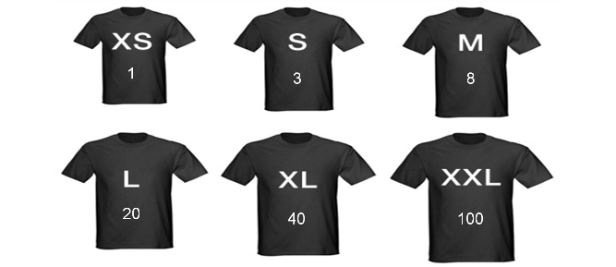
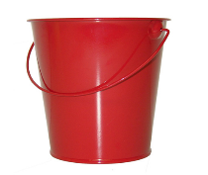

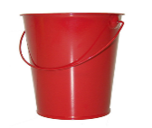

Story estimation – story points
Estimates are in story points (t-shirt sizes, bucket sizes, etc) – not hours!
Story point values must be in the Fibonacci series
0, 1, 2, 3, 5, 8, 13, 21, 34, … OR 0, 1, 2, 3, 5, 8, 13, 20, 40, 60, 100
Can have infinity as a value – too much unknown
Must fit in the bucket!
The smaller the story the better the more accurate the estimate!
Can break a story into smaller stories – Product Owner must agree!
1
2
3
5

Slide 9
Story estimation – story points (cont)
Must consider: Effort, Complexity, Unknowns
Effort – the amount of actual work. Example: How long does it take to put together a wall of a house?
Complexity – the complexity of the work. Not all work is equal! How long does it take to put together a circular wall of a house?
Unknowns – how well do we know everything? Do we know everything going into the wall? What if it ties in to another wall? Does it have a doorway?

Slide 10

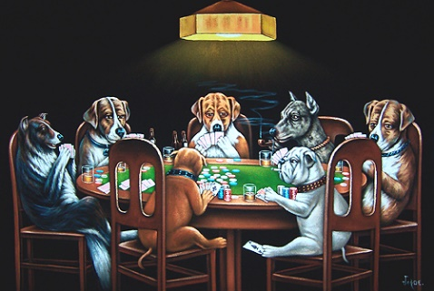
Story estimation – Playing poker
Use poker cards to assign values.
Development team members (no one else!!) hold one of each card from the Fibonacci series.
Scrum Master calls for the vote: Ready to vote? 1 … 2 … 3!
Each team member shows the card they selected for story size. Everyone has to show! No abstaining! Must be committed as a team!
Continue to revote until 100% consensus

Slide 11

Sprint Planning

Slide 12
Sprint planning
Done at the start of a sprint
Some organizations do prep work before the sprint starts – Not pure Scrum
The sprint planning ceremony is time boxed! Goal = Less than 2 hours
Sprint planning time is removed from the capacity (next section) of the sprint

Slide 13
Sprint planning – Product owner
Provides description of the user story.
Answers questions from the team.
Represents the business and end user.
Final authority on feature/functionality
Cannot vote – approach, design, task hours

Slide 14
Sprint planning – Scrum master
Facilitates sprint planning
Make certain everyone keeps focused and on task
Time boxes the event and voting
Referees conflict
Records obstacles and impediments (unknowns) – works to resolve as soon as possible
Does not vote! Does not have a say on approach!

Slide 15
Sprint planning – Development team
Breaks a user story into tasks.
Assigns an estimate in people hours to each task
Asks questions related to the user story, feature, design, or technical approach
Team must agree on design and approach
Must consider design, testing, and other tasks to ensure story is done (future lecture)

Slide 16

Sprint planning - process
Scrum Master facilitates – reserve room, virtual meetings, sends out documents, keeps everyone on tasks.
Scrum Master / Team determine capacity (next section).
Product Owner presents first user story.
Team breaks user story into tasks. Assigns tasks hours.
Scrum Master deducts each task’s hours from capacity until there is no capacity left. Note: some organizations use a fudge factor

Slide 17
Sprint planning – process (cont)
Keep breaking user story into tasks until all tasks have been identified and assigned an hourly value
Once complete with tasks and hourly estimates, the development team Decides whether it can commit to the user story or not. Product Owner and Scrum Master do NOT have a vote!
If there is enough time left in capacity – moves on to next user story from product backlog

Slide 18
Sprint planning – process (cont)
Product Owner selects the next user story from the Product Backlog. Note: the next story may NOT be the next one in the order of priority. Reasons – too big for the remainder of the sprint, another story may be related to one already accepted, other
Accepted user stories are not part of the Sprint Backlog. All of the tasks are grouped under the user story -> Story Board

Slide 19
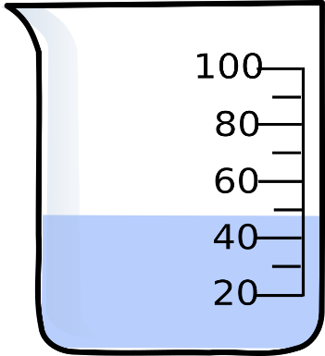
Capacity
Capacity = number of hours the development team has available during sprint.
Must consider vacation, holidays, and other requirements
Capacity = # of Development Team members times the number of planned working hours per day times the number of days in a sprint
Example: Capacity for Sprint 1 = 6 developers x 7 hours per day x 10 days – 12 hours (Sprint planning time!)
May calculate each team member separately – use Excel Spreadsheet or other tools!

Slide 20
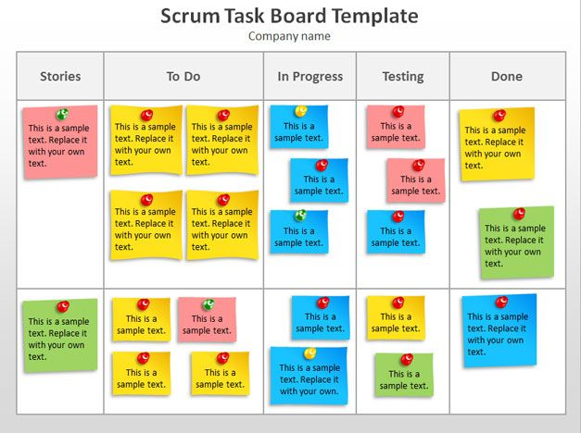
Story Board

Slide 21
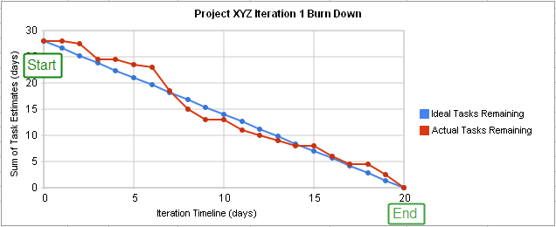
Burn-down chart

Slide 22
Questions

Slide 23
References:
Ruler Worm = http://www.clipartkid.com/length-measurement-for-teachers-cliparts/
Question mark = http://www.agile-code.com/blog/easy-task-estimation-with-three-point-estimation-technique/
Poker cards = https://pmtribe.wordpress.com/2010/10/04/product-management-poker/
Dogs playing poker = https://www.pinterest.com/pin/86623992803308839/

Slide 24
References (cont):
Spring planning = http://marchoeijmans.blogspot.com/2012/08/sprint-planning-meeting.html
Circle with arrows = http://www.clipartkid.com/circle-arrows-cliparts/

